Slide 1

National Institute of Technology Agartala
TOPIC : ELECTROMAGNETIC WAVES AND FIELDS
NAME – AVINASH KUMAR
ENROLLMENT NO.- 21UEE013
SEMESTER-3rd
DATE- 02/09/2022
SLIDE NO.- 01

Slide 2
Contents
INTRODUCTION
What are Electromagnetic Waves? How do they work?
Characteristics of EM Waves
Types of Electromagnetic Waves
Electromagnetic Spectrum
Electromagnetic Field
Uses Of Electromagnetic Waves
Hazards Caused By Electromagnetic Waves
DATE- 02/09/2022
SLIDE NO.- 02

Slide 3
What are Electromagnetic waves? How do they work?
Electromagnetic waves are also known as EM waves. Electromagnetic radiations are composed of electromagnetic waves that are produced when an electric field comes in contact with the magnetic field.
It can be said that electromagnetic waves are the composition of oscillating electric and magnetic fields.
Electromagnetic Waves were first discovered by Heinrich Hertz, which was initially proposed by James Clerk Maxwell.
DATE- 02/09/2022
SLIDE NO.- 03

Slide 4
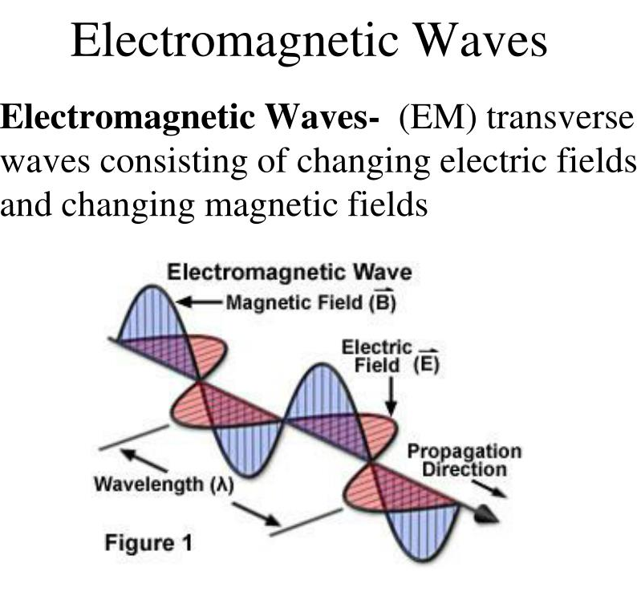
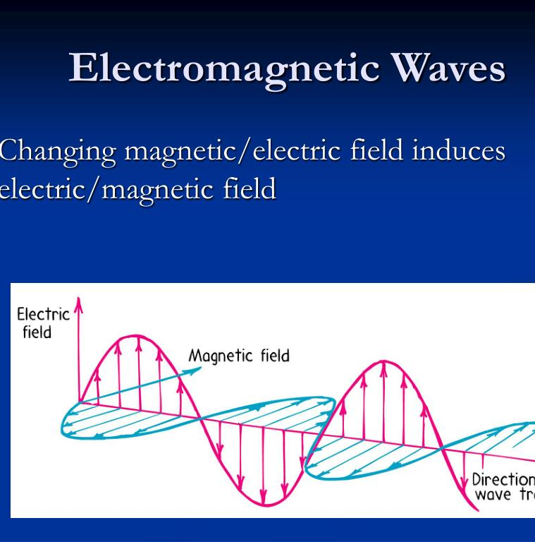
DATE- 02/09/2022
SLIDE NO.- 04

Slide 5
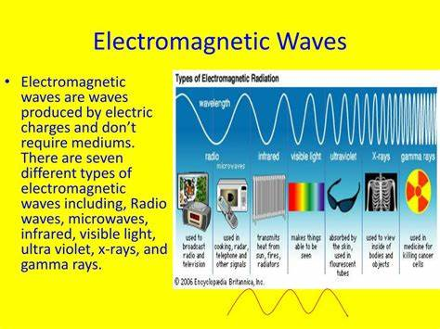
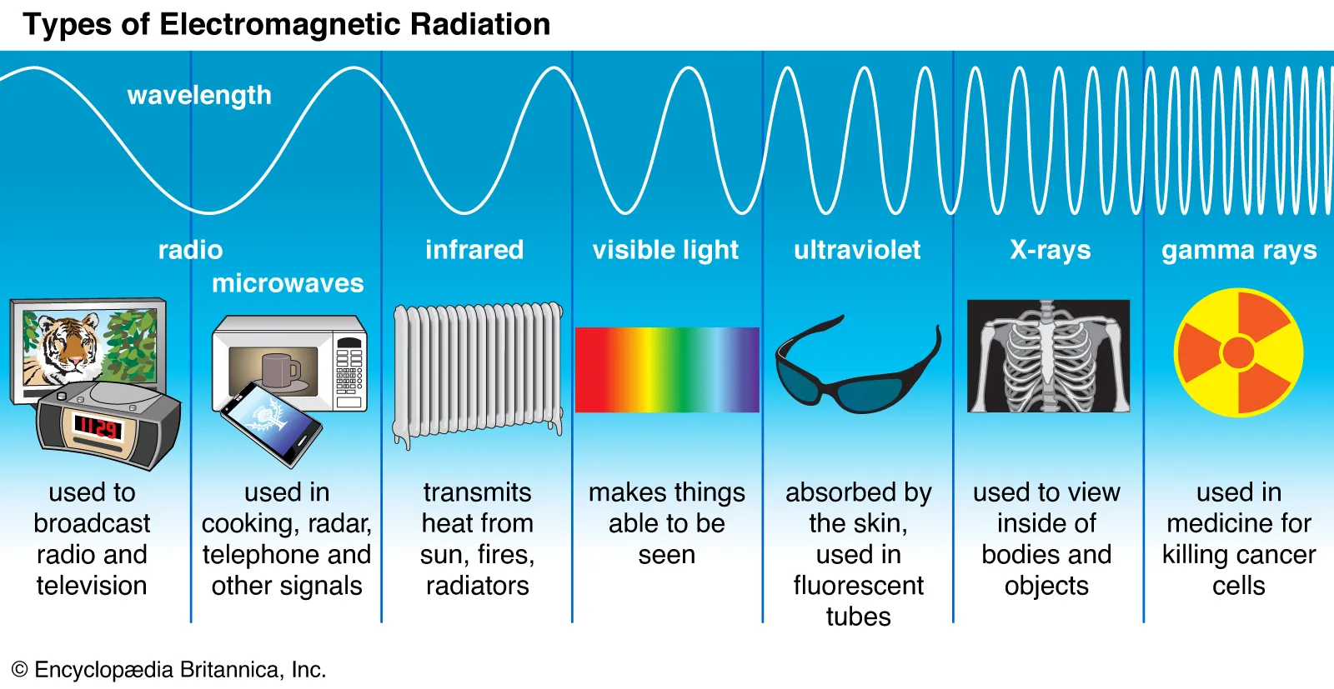
TYPES OF ELECTROMAGNETIC WAVES
DATE- 02/09/2022
SLIDE NO.- 05

Slide 6
Electromagnetic Field
Electromagnetic fields are a combination of invisible electric and magnetic fields of force. They are generated by natural phenomena like the Earth's magnetic field but also by human activities, mainly through the use of electricity.
Every organ and cell in the human body has its own field. The magnetic field produces electrical currents that are weaker than you may first think. At the same time, the electromagnetic field of the brain is stronger than the heart.
DATE- 02/09/2022
SLIDE NO.- 06

Slide 7
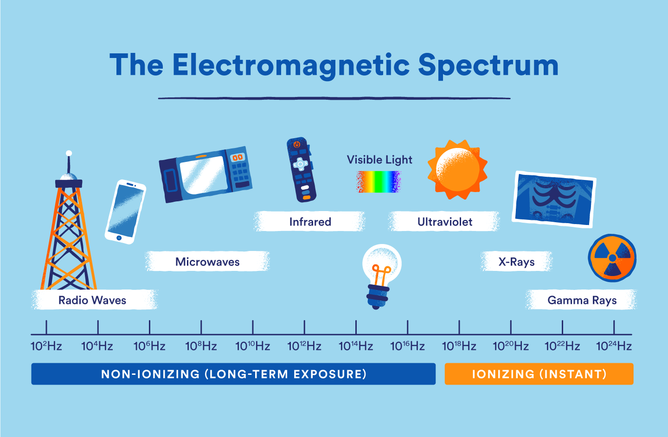
Uses of Electromagnetic Waves
Electromagnetic waves have a vast range of practical everyday applications that includes such diverse uses as communication by cell phone and radio broadcasting, Wi-Fi, cooking, vision, medical imaging, and treating cancer.
Electromagnetic waves are used to transmit long/short/FM wavelength radio waves, and TV/telephone/wireless signals or energies. They are also responsible for transmitting energy in the form of microwaves, infrared radiation (IR), visible light (VIS), ultraviolet light (UV), X-rays, and gamma rays.
DATE- 02/09/2022
SLIDE NO.- 07

Slide 8
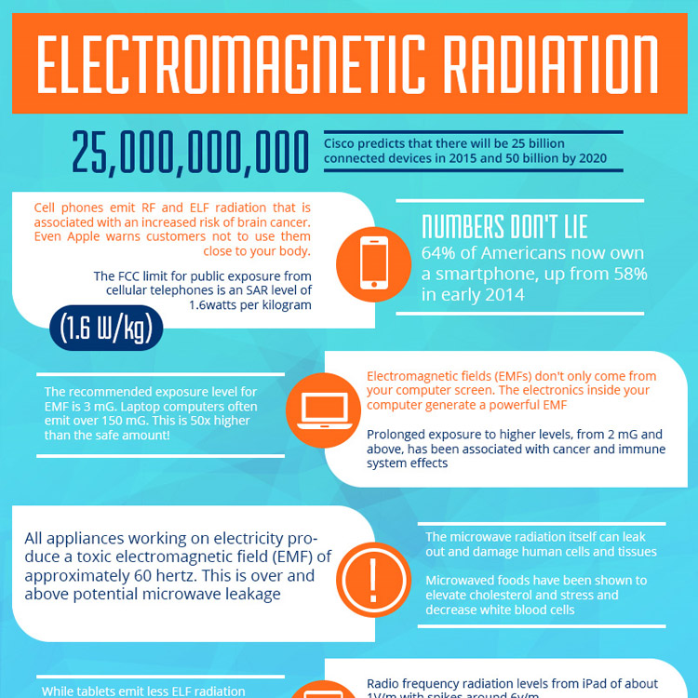
HAZARDS CAUSED BY ELECTROMAGNETIC WAVES
DATE- 02/09/2022
SLIDE NO.- 08

Slide 9

THANK YOU
DATE- 02/09/2022
SLIDE NO.- 09

